Slide 1
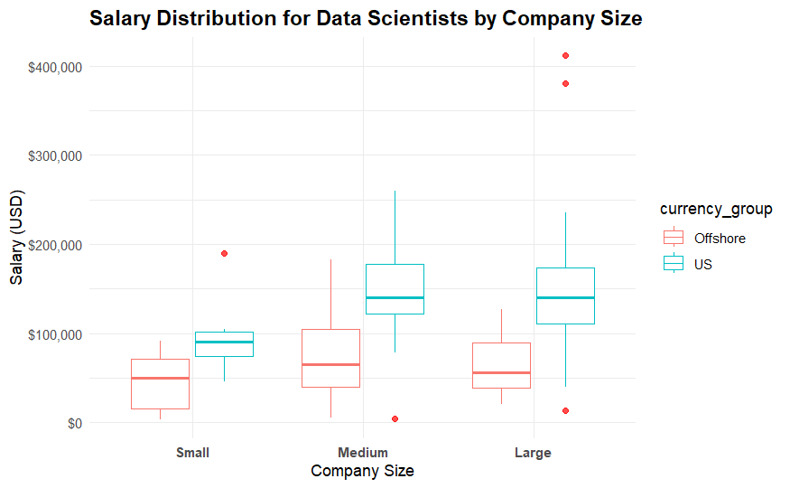
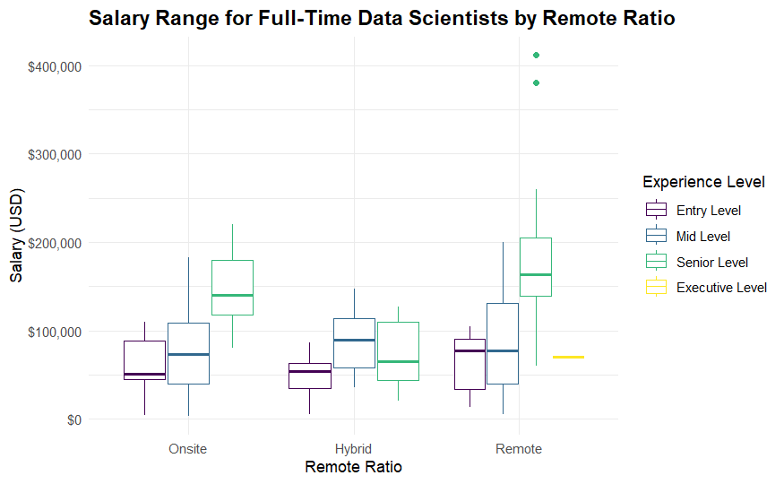
Data Scientist Salary Analysis
Alexis Root
02/16/2026
Cost Efficiency Insights for Hiring Full Time Data Scientist
Employee location, company size, onsite versus remote, and experience level analyzed

Slide 2
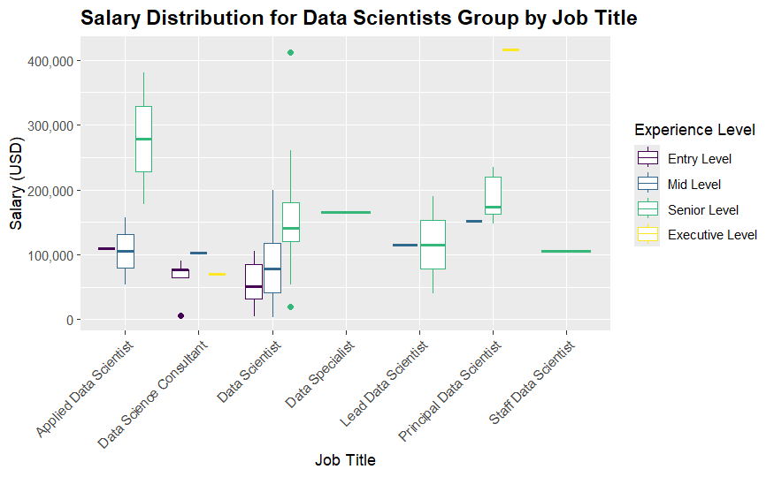
Data Scientist Grouping
Grouped like job titles together for data scientists
Wide range in salary and array of skills when not grouped

Slide 3
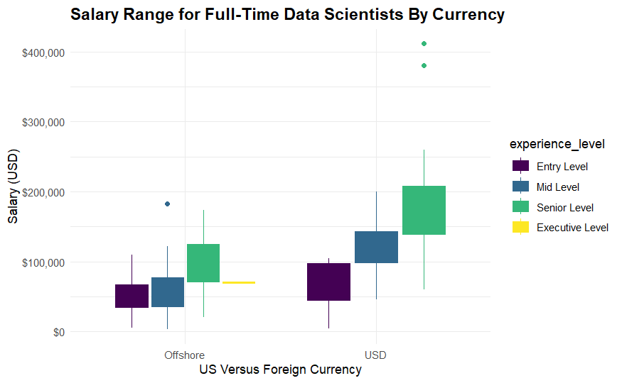
Salary Ranges
Senior offshore hiring cost is in the same range as entry-mid level US hiring range

Slide 4
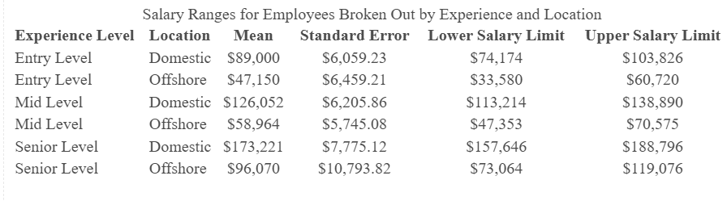
Outcomes
Offshore employees cheaper
Opportunity to hire more experienced employee at lower cost
Salary range not heavily impacted by remote ratio or company size
Salary Ranges calculated using 95% confidence interval

Slide 5
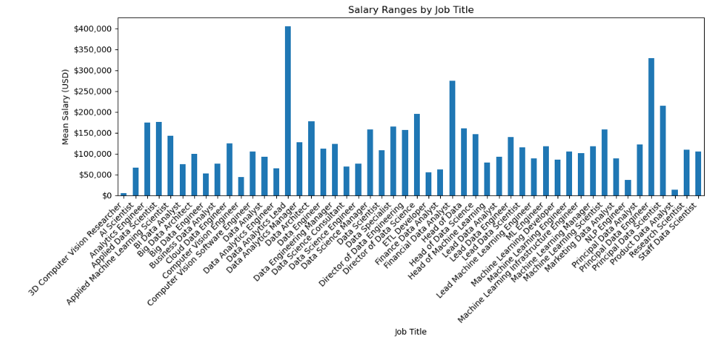
Appendix
Job title salary ranges when not grouped

Slide 6
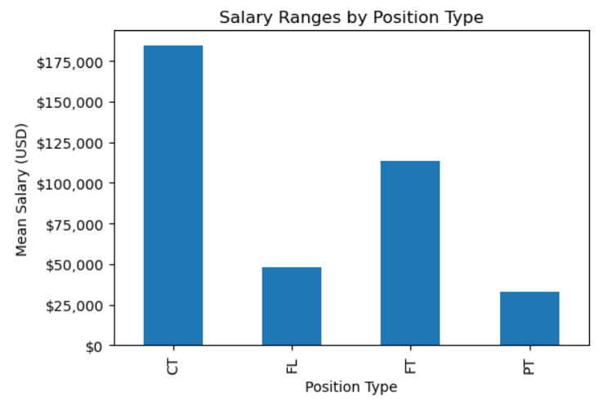
Appendix
Contractors have significantly higher salary ranges

Slide 7
Appendix
Welch Two Sample t-test Results for Mid Level Employees
t-statistic Mid Level: 7.798
p-value Mid Level: 1.645e-10
Mean Domestic Mid Level Salary: $126,052.08
Mean Offshore Mid Level Salary: $59,433.40
There is a very small chance that there is not a difference between offshore versus US employees
Significant difference shown between salary ranges of the two groups
Welch Two Sample t-test Results for Senior Level Employees
t-statistic Senior Level: 5.409
p-value Senior Level: 1.228e-05
Mean Domestic Senior Level Salary: $173,221.05
Mean Offshore Senior Level Salary: $96,421.36

